Slide 1
HUMAN RESOURCES ANALYTICS
Presented by
Subha Bose
Parth Thaker

Slide 2
What does Human Resource (HR) Actually Do ?
Department or function responsible for managing and overseeing the organization's human capital.
Recruitment and Staffing:
Compensation and Benefits
Termination and Exit Interviews

Slide 3

What is Attrition ?
reduction in the number of employees within an organization over time.
employees leave a company, and the organization may or may not replace those departing employees.
Factors include:
Work-Life Balance
Job Satisfaction
Compensation and Benefits

Slide 4

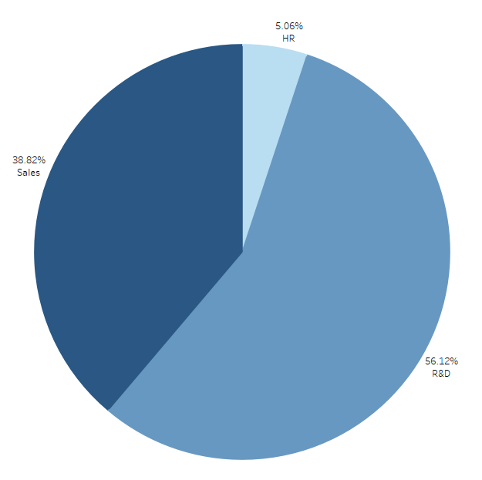



Department Wise Attrition
Top 3 Departments
R&D
Sales
HR

Slide 5
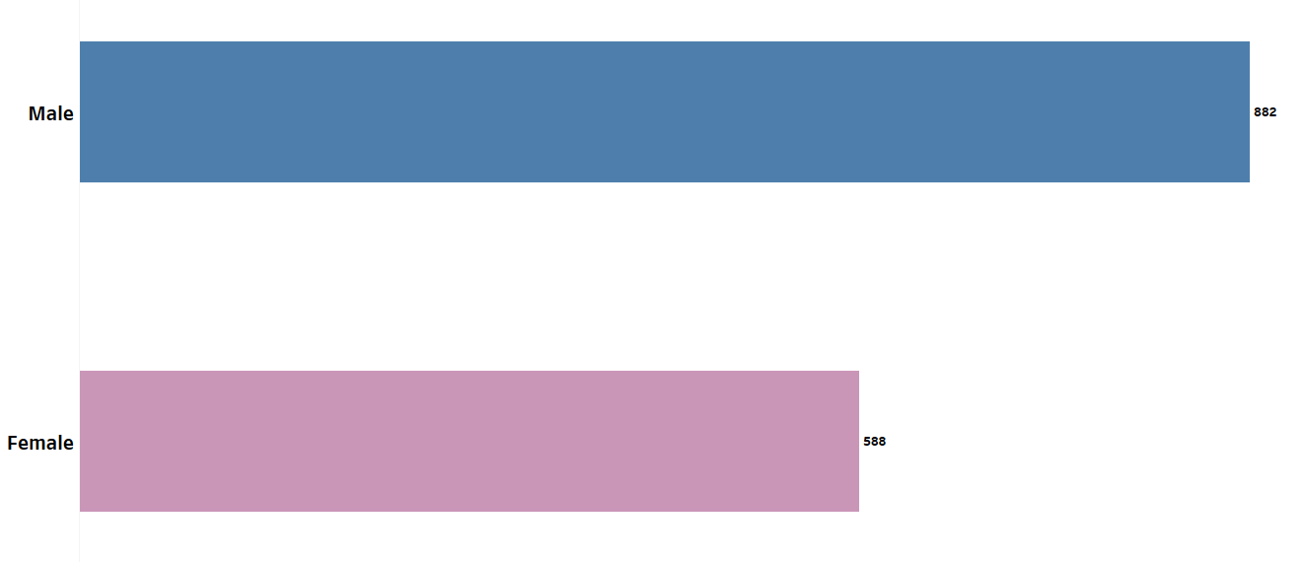
Attrition by Gender

Slide 6

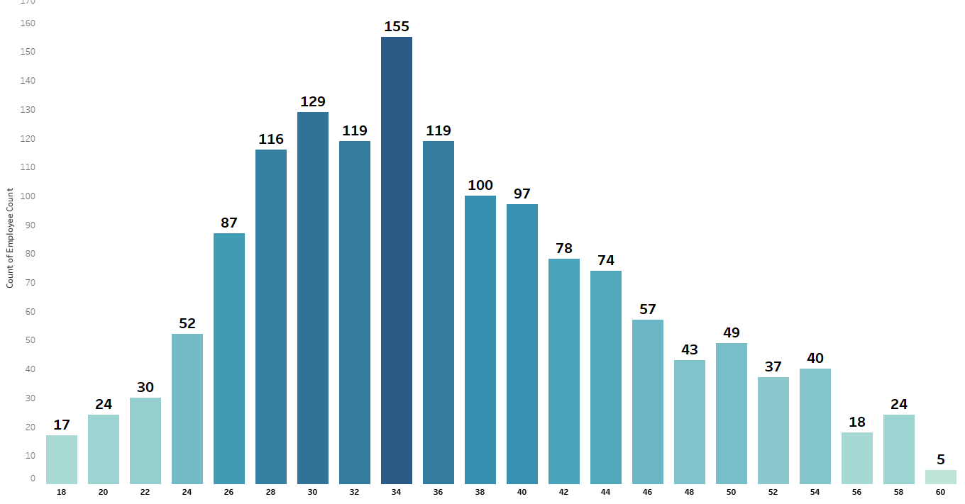
Number of Employees by Age Group

Slide 7
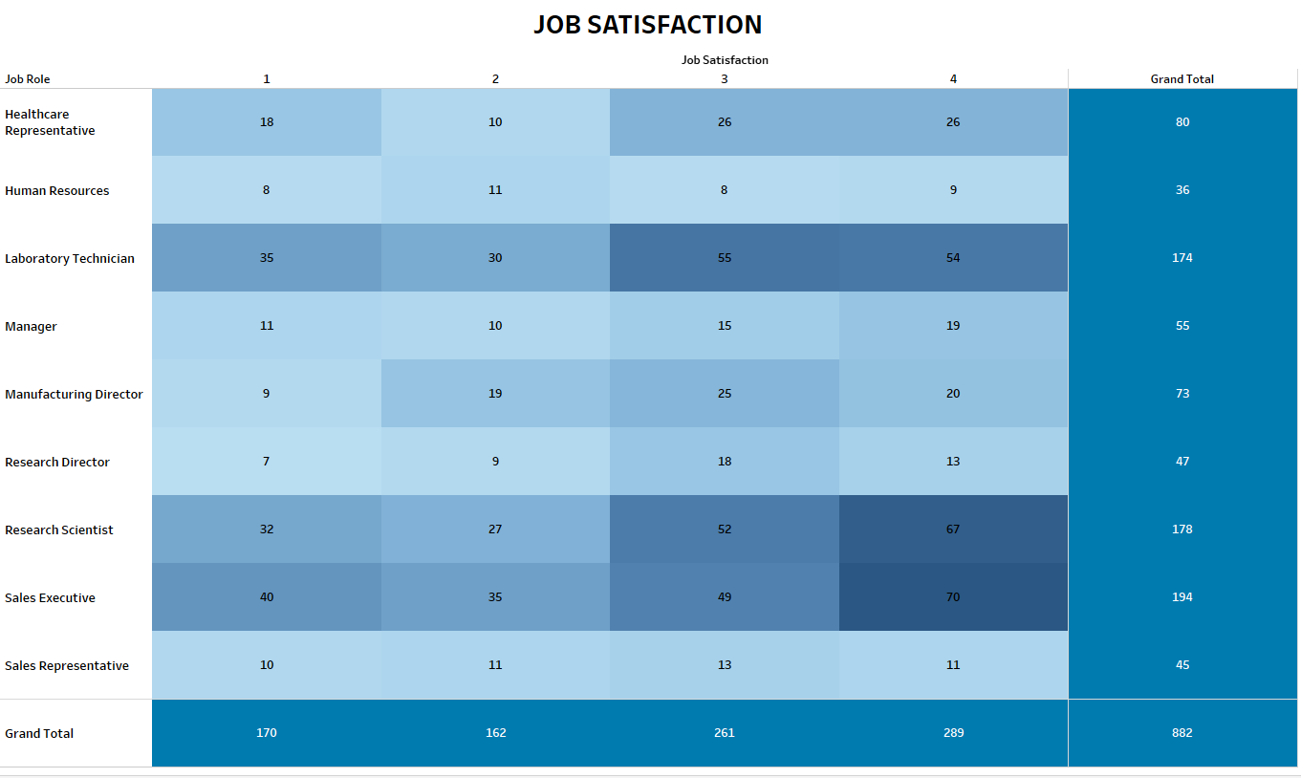
Job
Satisfaction

Slide 8
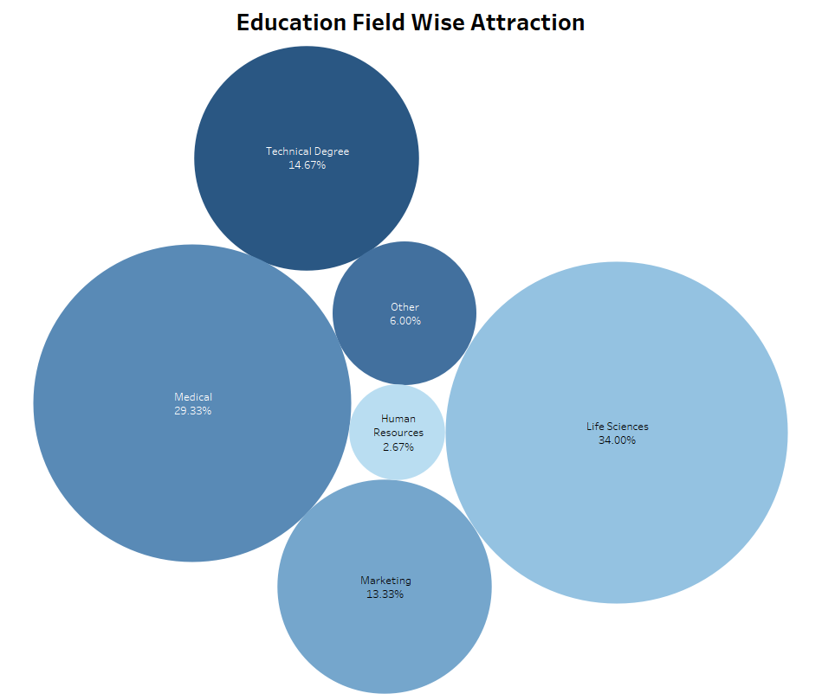
Education Field Wise Attrition

Slide 9
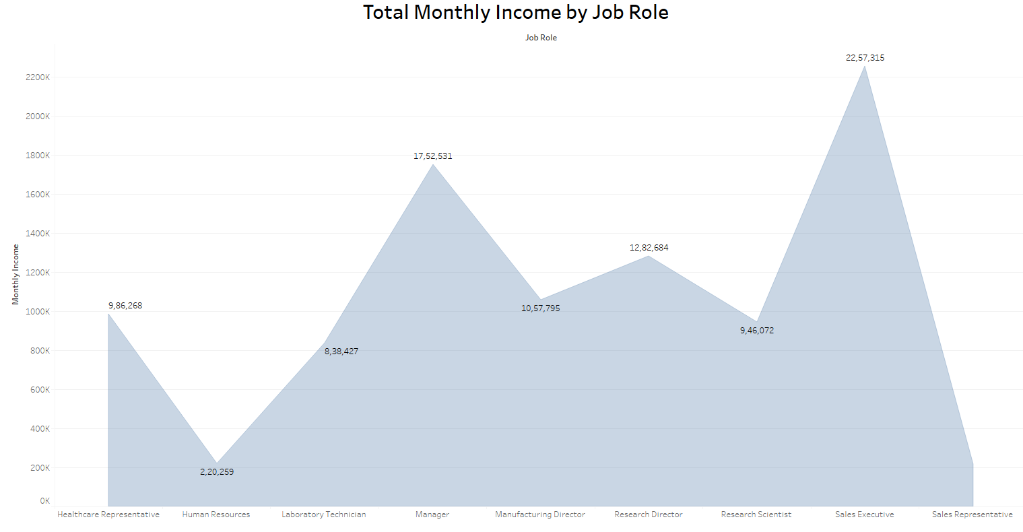
Total Monthly Income by Job Role

Slide 10
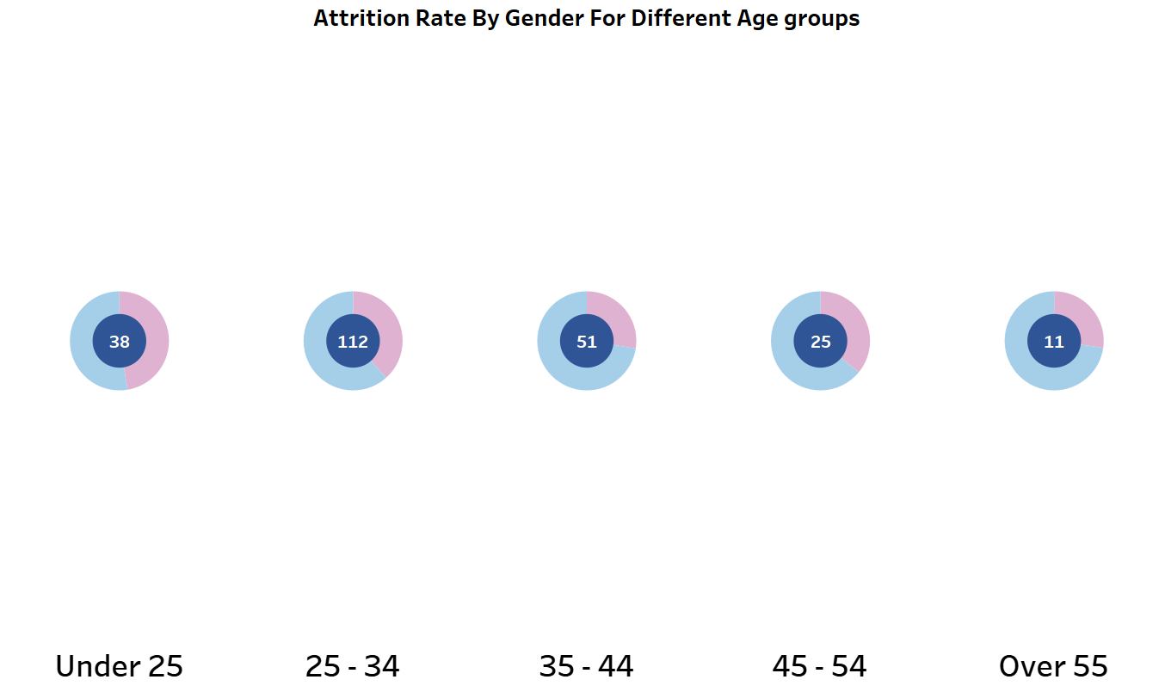
Attrition Rate By Gender For Different Age groups

Slide 11
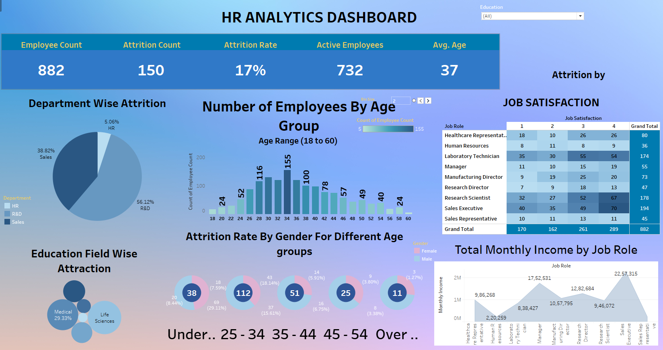
All at Once !

Slide 12

Insights!
By Conclusion we can say that the following Company is a Medical Company which focuses on Research and Sales for their Earnings.
R&D Department has the Highest Rate of Attrition with 56.12%
Human Resources has the lowest level of Job Satisfaction with only 9 people voting for 4 in Job Satisfaction

Slide 13
THANK YOU !!!

